Slide 1
Patient Engagement Overview
New Investigator Clinical Trials Course
Judy Needham
Chair, Patient Representative Committee
Member, Clinical Trials Committee
Member, Strategic Executive Advisory Council
Kingston, ON
August 3, 2022

Slide 2









Disclosures / Affiliations
2

Slide 3
Goal
Overview of CCTG’s overarching Patient Engagement Strategy
Overview of what Patient Representatives are trained to do in CCTG
Some realized benefits of patient engagement in research
Tips in engaging Patient Representatives
Learning Objective
Given this information, participants will be able to meaningfully engage Patient Representatives in:
  the design, development and delivery of your (CCTG) clinical trials, and
  committee meetings.
3

Slide 4
Goal 1
The CCTG
2022 – 2027 Strategic Plan
Patient Engagement Strategy
4

Slide 5
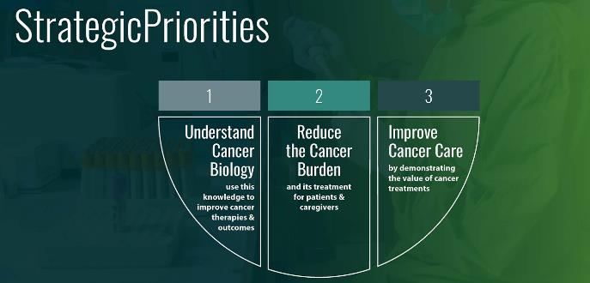
The CCTG Patient Engagement Strategy
Priority 2 – Reduce the Burden of Cancer
AND ITS TREATMENT FOR PATIENTS & CAREGIVERS
“Through this strategic priority, CCTG will develop a portfolio of trials and trial-related activities that will emphasize the assessment and reduction of the burden of treatment on patients and incorporate the patient perspective."
5

Slide 6
The CCTG Patient Engagement Strategy
“CCTG trials
• Address questions important to researchers, clinicians and patients;
• Evaluate interventions that are innovative; have the potential to change clinical practice;
• Reflect an international caliber of science; and,
• Include patients as partners.”
6

Slide 7
Goal 2
Overview of
Patient Engagement in CCTG
7

Slide 8
Patient Engagement in CCTG
CCTG has a dedicated patient engagement model
Committee-specific positions are posted and Patient Representatives (PRs) are recruited from across Canada,
PRs are assigned to Disease Site, Endpoint, and Oversight Committees for a (once-renewable) 3-year term,
Based on Committee size and activity, one or two PRs per Committee
Criteria
  a lived experience as either a patient or caregiver in the Disease Site cancer,
  comfort in representing the patient perspective in a primarily scientific environment/meeting,
  desire and ability to review and comment on new proposals, protocol, consent and patient-facing materials with respect to patient related items,
  ability to access all meeting and trial information electronically, and
  capacity to train, prepare for, and attend all committee meetings and Spring Meetings.
8

Slide 9
Patient Engagement in CCTG
Canadian Cancer Trials Group Patient Representative
Train
Recruit
Orient
Engage
Train
Orient
Recruit
Patient Representative Terms of Reference Patient Representative Roles & Responsibilities
IAP2
Inform
Involve
Collaborate
9

Slide 10
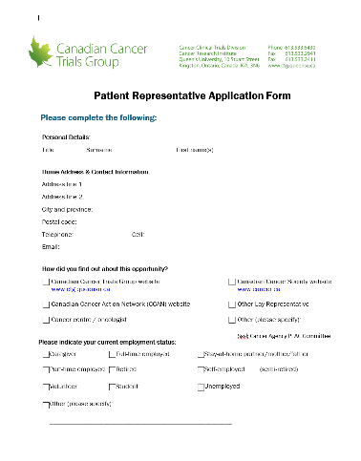
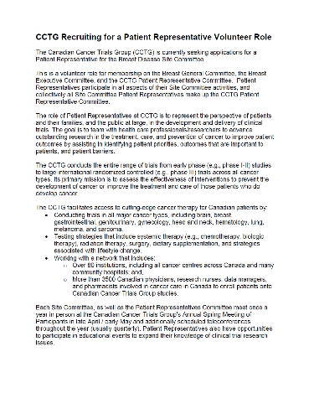
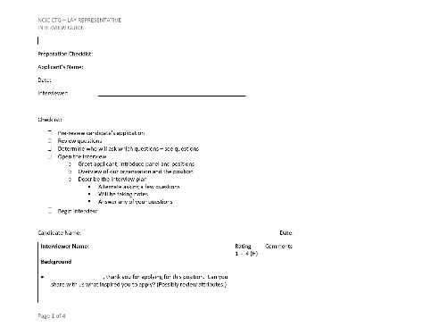
Patient Engagement in CCTG
Engage
Train
Orient
Recruit
Recruit
Positions are posted across Canada at Centres, Patient Advocacy Groups, CCTG website, CCS, etc.
Applications received
Interview and selection process with CO support and PRC Chair
  Includes consult with Committee leadership
10

Slide 11
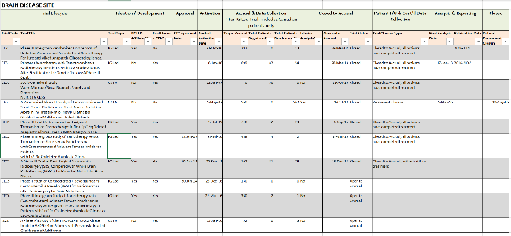
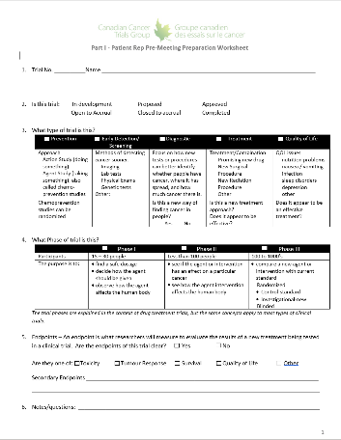
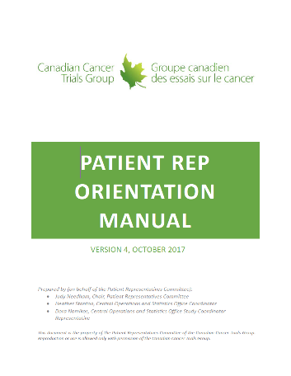
Patient Engagement in CCTG
Engage
Train
Orient
Recruit
Orient
2.0 hr. Orientation (Virtual)
PRC Chair, CO Support, Study Coordinator
  Organizational Overview
  Committee Overview and meeting schedule
  DSC Trial Matrix Report
  Clinical Trial Touchpoints
  Website Overview
Introductions to Committee Leadership and members.
4.0 hr. Training (Spring Meeting), PRC Chair, CO Support
Ideation
Proposal Development
Proposal Review / Approval
Develop Protocol & Consent
Operations Centre Activaton
Cancer Centres Activation
Accrual & Data Collection
Closure to Accrual
11
Follow Up/Data Collection
Endpoint(s) Met
Analysis & Reporting
Permanent Closure

Slide 12
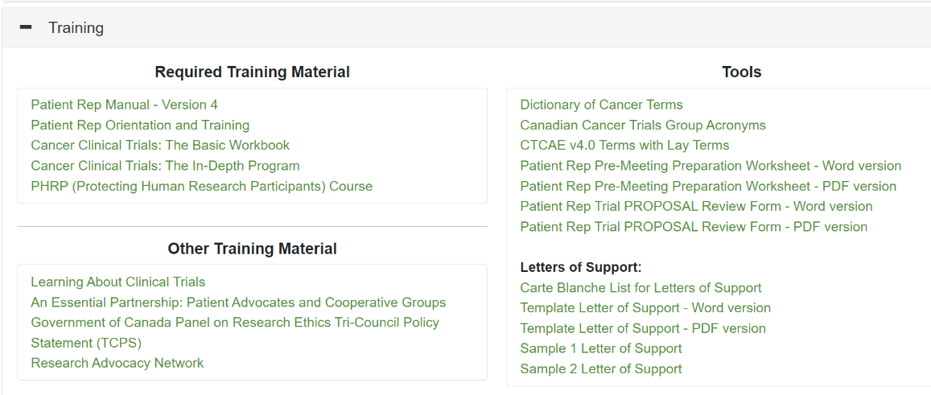
Patient Engagement in CCTG
Engage
Train
Orient
Recruit
Training – Patient Rep Training Website
12

Slide 13


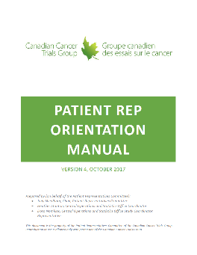

Patient Engagement in CCTG
Engage
Train
Orient
Recruit
Training – Patient Rep Training Website
13
13

Slide 14



Patient Engagement in CCTG
Training – Patient Rep Training Website
14

Slide 15



Patient Engagement in CCTG
Optional Training - Research Advocacy Network Tutorials
(NCI NCTN Shared Patient Advocate Resources)
Understanding Clinical Trial Design
Understanding Cancer Risk
Quality of Life and Patient Reported Outcomes
Liquid Biopsies
Targeted Therapies
Molecular Diagnostics in Cancer
Genomics in Cancer
Pathology and Tissue Research
Precision Medicine in Oncology
https://researchadvocacy.org/pdf-resources?tid=48
Some
Examples
15

Slide 16

Patient Engagement – CCTG Governance
Queen's University Board of Trustees
Dean Faculty of Health Sciences
Strategic Executive Advisory Council (SEAC)
Fiduciary responsibility and Legal Entity
Advice on strategy and policy
Director, Operations and Statistics Centre (OSC)
Clinical Trials Committee (CTC)
Data Safety Monitoring Committee (DSMC)
OSC Executive
Review of new proposals, renewals, scientific issues
Safety and efficacy of ongoing clinical trials
OSC Management & Operations
Legend:
Patient Engagement
16

Slide 17


Patient Engagement – CCTG Committees
Brain
Breast
GI
GU
Gynecological
Hematology
H&N
Lung
Melanoma
Sarcoma
Supportive Care
Scientific Committees
Disease Sites
Investigational New Drug (IND) Program
Oversight
Governance Committees
Clinical Trials
Data Safety Monitoring
Support Committees
CRA
Patient Rep
Strategic Executive Advisory
Endpoint Committees
Pharmacy
Auditing Monitoring
Centre Representative
RTQA
Quality of Life
Economic Analysis
Correlative Biology / Banking
85 member sites and 2100 Canadian Investigators
Legend:
Patient Engagement
Operations and Statistics Centre at Queen’s (100 + Staff & 12 Faculty)
17

Slide 18

Patient Engagement – CCTG Network
Collectively a Pan-Canadian Patient Voice
Robert Taylor, Canmore, AB
Marg Redlick, Grand Prairie, AB
Bill Richardson, Calgary, AB
Robin Fried, Vancouver, BC
Richard Wassersug, Vancouver, BC
Patrick Sullivan, Vancouver, BC
Marie-Terese Little, Victoria, BC
Judy Needham, Abbotsford, BC
Louise Bird, Braymer, SK
Sylvie Desmarais ,
Longueil, QU
Janice Hodgson, Newmarket, ON
Jennifer Cicci, Toronto, ON
Helen Ghent, Sudbury, ON
David McMullen, Ancaster, ON
Joan Petrie, London, ON
Lynne Bezanson, Ottawa, ON
Jill Hamer-Wilson, Ottawa, ON
Martina Wood, Mississauga, ON
Carol Gordon
Erwin Wanderer,
Halifax, NS
18

Slide 19
Patient Engagement in CCTG
Engage
Train
Orient
Recruit
Engage
The role of Patient Representatives in the Canadian Cancer Trials Group (CCTG)
    is to represent the perspective of patients and their families, and the public at large, in the development and delivery of cancer clinical trials.
This is achieved by
    teaming with health care professionals/researcher, and
    providing formal patient input at defined patient touchpoints in the CCTG clinical trial lifecycle, from ideation through to trial closure.
19

Slide 20
Patient Engagement in CCTG
Engage
Train
Orient
Recruit
Ideation
Engage
Proposal Development
The role of Patient Representatives in the Canadian Cancer Trials Group (CCTG)
    is to represent the perspective of patients and their families, and the public at large, in the development and delivery of cancer clinical trials.
This is achieved by
    teaming with health care professionals/researcher, and
    providing formal patient input at defined patient touchpoints in the CCTG clinical trial lifecycle, from ideation through to trial closure.
Proposal Review / Approval
Develop Protocol & Consent
Operations Centre Activation
Cancer Centres Activation
Accrual & Data Collection
Closure to Accrual
Follow Up/Data Collection
  With the objective of
    Identifying potential patient barriers in trial development and design, inclusion of patient-centred endpoints, and accrual planning.
Endpoint(s) Met
Analysis & Reporting
Permanent Closure
20

Slide 21
The Canadian Cancer Trials Group Clinical Trial Lifecycle
Members
Operations and Statistics Centre
Ideation
Member Investigators
Disease Site Committees
and Executives
Proposal Development
Senior Investigators
Proposal Review / Approval
Clinical Trials Committee
Develop Protocol & Consent
Trial Team Members
Operations Centre Activation
Cancer Centres Activation
Trial Team
Support Departments
Accrual & Data Collection
Member
Cancer Centres
Closure to Accrual
Follow Up/Data Collection
Endpoint(s) Met
Independent Data Safety
Monitoring Committee
Analysis & Reporting
Permanent Closure
21

Slide 22
The Canadian Cancer Trials Group Clinical Trial Lifecycle
Members
Operations and Statistics Centre
Ideation
DSC Chair, SI, PI
Member Investigators
Disease Site Committees
and Executives
Proposal Development
Senior Investigators
Proposal Review / Approval
Clinical Trials Committee
Develop Protocol & Consent
Trial Team Members
Operations Centre Activation
Cancer Centres Activation
Trial Team
Support Departments
Accrual & Data Collection
Member
Cancer Centres
Closure to Accrual
Follow Up/Data Collection
Legend:
Current
Patient Engagement
Planned
Patient Engagement
Endpoint(s) Met
Independent Data Safety
Monitoring Committee
Analysis & Reporting
Permanent Closure
22

Slide 23
The Canadian Cancer Trials Group Clinical Trial Lifecycle
Members
Operations and Statistics Centre
Ideation
DSC Chair, SI, PI
Member Investigators
Disease Site Committees
and Executives
Proposal Development
Senior Investigators
PRC
Chair
Proposal Review / Approval
Clinical Trials Committee
Study
Co-ord (SC)
Develop Protocol & Consent
Trial Team Members
Operations Centre Activation
SC, Comm Lead
Cancer Centres Activation
Monthly electronic reports, meetings, accrual tool,, SC, Chair
Trial Team
Support Departments
Accrual & Data Collection
Member
Cancer Centres
Closure to Accrual
Follow Up/Data Collection
Legend:
Current
Patient Engagement
Planned
Patient Engagement
Endpoint(s) Met
Independent Data Safety
Monitoring Committee
Analysis & Reporting
Permanent Closure
23

Slide 24
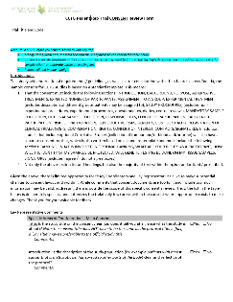
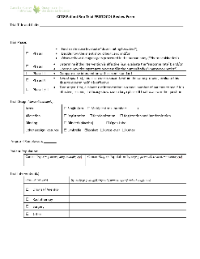
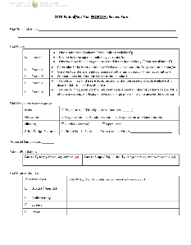
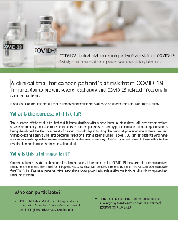
Patient Engagement in CCTG
Engaging – tools to do the job
Tools to do the job
New Proposal Review Form
Protocol Development and Review Form
Consent Development and Review Form
Plain Language Summaries Template
24

Slide 25




Phase III - Patient Engagement – CCTG Trials
CCTG Patient Engagement from Ideation to Closure
Primes for
Engaging
DSC Chair, SI, PI
DSC Chair, SI, PI
PRC
Chair
Study
Co-ord (SC)
SC, Comm Lead
Monthly electronic reports, SC, Chair
Clinical
Trial
Lifecycle
Priority
Setting/
Ideation
Review,
Prioritize &
Fund
Trial ..
Activation
Across
Canada
Accrual
and
Data
Collection
Closure
To
Accrual
Analysis
And
Reporting
Change
In
Practice
Proposal
Development
Protocol
& Consent
Development
Endpoint(s)
Met
Trial
Closure
Patient
Reps
DSC Reps / PAGs
Annual and 5-Year Strategic Planning – Provide patient priorities input for consideration in Committee Strategic Priorities
DSC Reps
Review Protocol and Consent for patient centred endpoints / feasibility
Provide input for plain language summaries for patients / public
DSC Reps
Identification of potential patient obstacles in trial design
Provide input into patient centred outcomes
DSC and CWG Reps
Provide input for recruitment strategies, patient facing material
CTC Reps
Gather input from DSC Patient Reps
Review new proposals from a patient perspective
Bring forward any patient concerns and/or suggestions
Score and prioritize
DSC Reps - Monitor trial for accrual issues / identify patient barriers
DSMC Reps – Monitor trial for safety issues
MTB Reps – Review candidates for CAPTUR
25

Slide 26
Goal 3
Learn about
Some Examples of Benefits
of
Patient Engagement
26

Slide 27
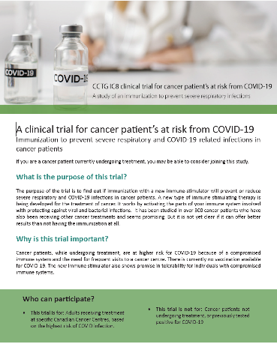
What Benefits Did Patient Engagement Bring?
Increasing Accrual
Plain Language Patient Facing Material to Accompany Consent
IC.8 Clinical Trial (NCT04442048) Immunization With IMM-101 vs Observation for Prevention of Respiratory and Severe COVID-19 Related Infections in Cancer Patients at Increased Risk of Exposure (COV-IMMUNO)
Influenced New Trials in the Pipeline
MYX.1 (NCT02597062)
A Phase II Study of High Dose Weekly Carfilzomib plus Cyclophosphamide and Dexamethasone in the Treatment of Relapsed Multiple Myeloma
Coordinated through Mr. Aldo Del Col, CCTG Patient Representative on the Hematology DSC

Slide 28
Increasing Accrual
What Benefits Did Patient Engagement Bring?
Influencing Trial Opening Internationally
CO.21 – NCT00819208
Health Education Materials With/Out a Physical Activity Program for Patients Who Have Undergone Treatment for High-Risk Stage II or Stage III Colon Cancer (CHALLENGE)
Patient appeal to support CHALLENGE Trial opening in the UK
Influencing Continued Drug Supply
PA.6 - NCT01526135
Trial Comparing Adjuvant Chemotherapy With Gemcitabine Versus mFolfirinox to Treat Resected Pancreatic Adenocarcinoma
Successful patient appeal to Sanofi Canada influencing continued drug supply in Canada

Slide 29
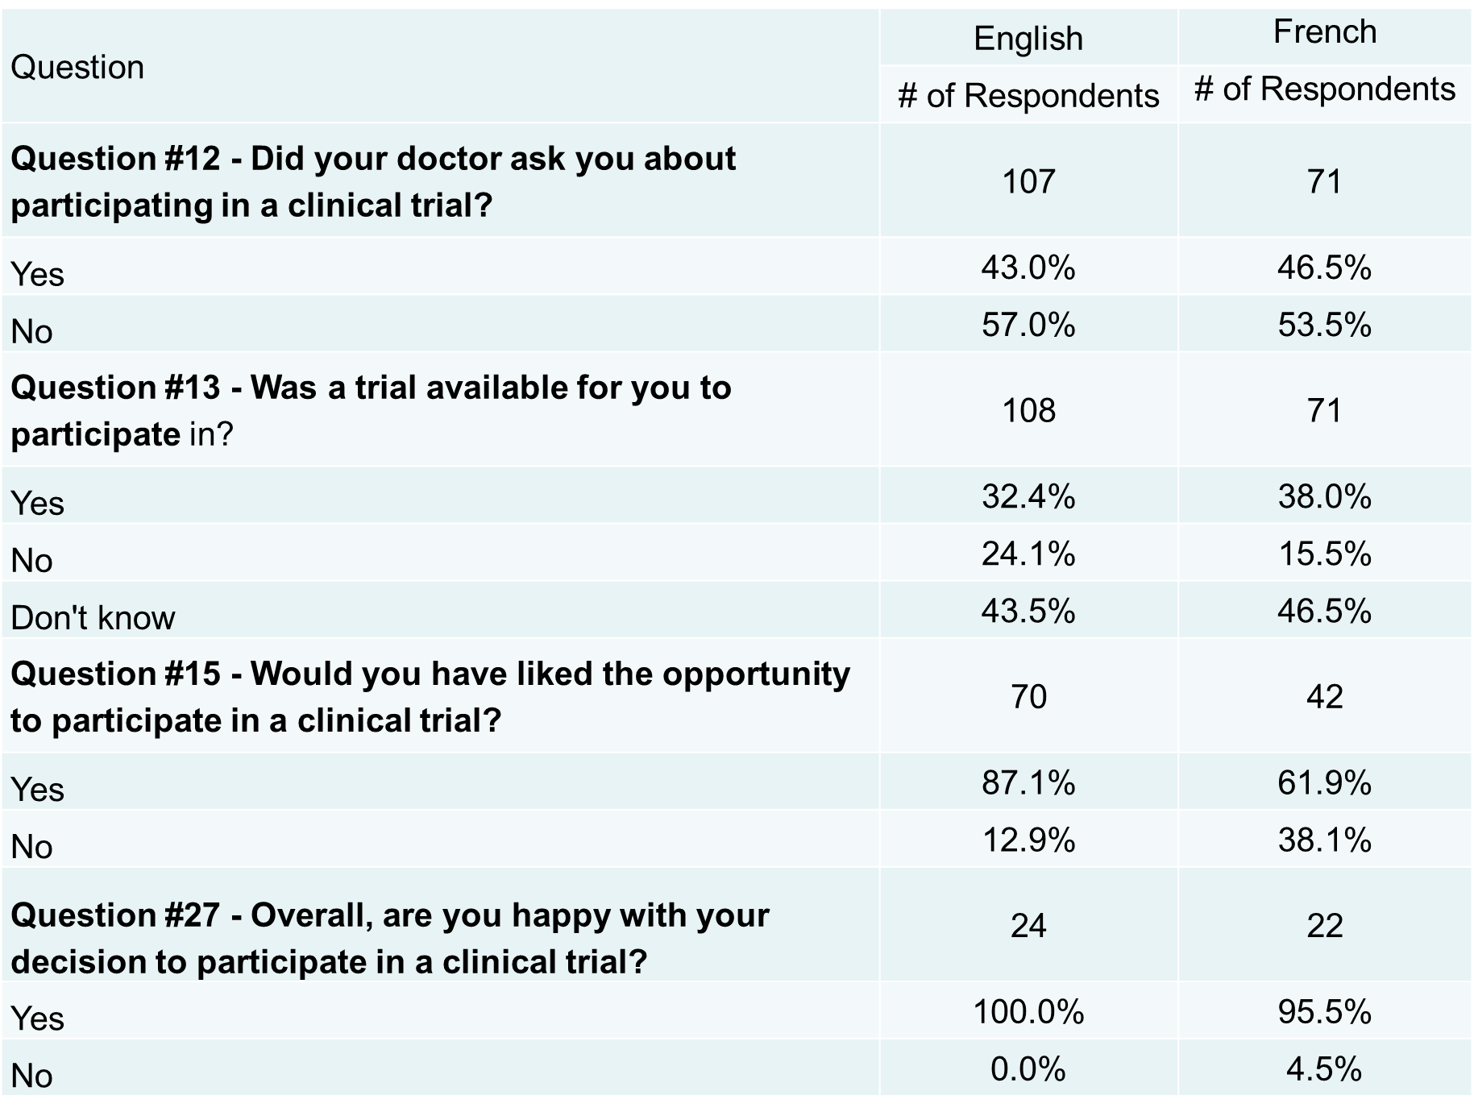
Increasing Accrual
What benefits Did Patient Engagement Bring?
Increased Awareness of Clinical Trials in Canada
Patient Representative designed and led Canada-wide survey in partnership with Ovarian Cancer Canada for women with gyne cancers to gauge their awareness of and experience with clinical trials
– Mary Manojlovich, Gynecological Disease Site Committee Patient Representative.

Slide 30
What Benefits Did Patient Engagement Bring?
Increasing Accrual
Inclusion of Patient-Centred Outcomes
INT230-6 (NCT047817250)
INVINCIBLE TRIAL: Intratumoral INT230-6 in Breast Cancer
PI: Dr. Angel Arnaout
Patient Partner: Judy Needham
OICR WOO Steering Committee Member
An Example of the Effect on Accrual
from Incorporating
Patient-Centred Outcomes
As
Secondary Endpoints in a Clinical Trial

Slide 31
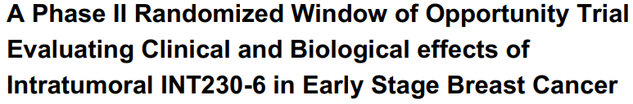

NCT047817250
The waiting time leading up to cancer surgery is an opportunity to evaluate the effectiveness and mechanisms of action of potential anticancer therapies with minimal side effects. These “window of opportunity” clinical trials are a powerful way to significantly accelerate cancer drug discovery research.

Slide 32
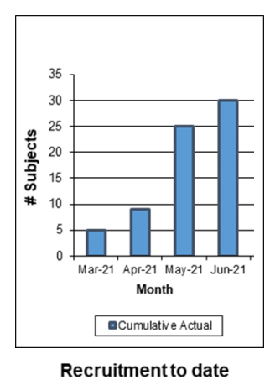
Understanding Patient and Clinician Perspectives on Participation in WOO Trials
Introduction of Patient Centred Outcomes
Surgeon Investigator: “Patients from other surgeons were coming to me asking if they could pay to participate in the clinical trial…they had apparently heard about this trial from other patients”
Patient: “The waiting time leading up to surgery is a very anxious time, where patients feel helpless and have lost control. Asking me about my level of anxiety and my emotional wellbeing as part of the study shows me that you care…at the end, if the drug does not work, I know that being able to feel more in control of my disease matters to me…and that is worth measuring”
Study PI: “Due to the persistently high accrual, I was able to feel more confident that introduction of a sham injection in the control arm, which would make the study more scientifically robust, would not deter patients away.”

Slide 33
Understanding Patient and Clinician Perspectives on Participation in WOO Trials
Clinician Centered Outcomes
Scientific Outcomes
Patient-Centred Outcomes
Accrual Outcomes (% accrual per patient approached; accrual on target timelines; % accrued participants completing study)
Word of Mouth Referral
(patients referred by other patients who have come specifically looking to be on study)
Physical Well-being
Social Well-being
Emotional Well-being
Functional Well-being
Self-efficacy
As measured through participant surveys before and at end of trial activity
Pathologic Complete Response
(% tumor in breast and involved lymph node killed with treatment while waiting for surgery)

Slide 34

More Through Partnerships
OPPORTUNITY from a Patient Perspective
Inclusion of patient-centred endpoints
34

Slide 35
Assisting in Increasing Funding
What Benefits Did Patient Engagement Bring?
Patient Rep Committee - Letters of Support
Date | Name of Study | Recipient of Letter | Signing Patient Rep
23-Aug-13 | NCIC CTG CO.21 trial -- A Phase III Study of the Impact of a Physical Activity Program on Disease-Free Survival in Patients with High Risk Stage II or Stage III Colon Cancer. | Dr. Vicky Coyle, Centre for Cancer Research and Cell Biology, Queen's University Belfast, Northern Ireland, UK | Judy Needham on behalf of CCTG Patient Representative Committee (PRC)
06-Sep-18 | Melanoma Margins Trial II – A Phase III, Multi-centre Randomized Controlled Trial Investigating 1cm v 2cm Wide Surgical Excision Margins for AJCC Stage II Primary Cutaneous Melanoma (MelMarT-II) (ME.15) | Dr. Frances Wright, University of Toronto and Dr. Janet Dancey, Director, CCTG | David McMullen on behalf of CCTG PRC
27-Mar-19 | Randomized Phase 2 Evaluation of Lower dose (3-2-1 Strategy) vs Full Dose of Ibrutinib for the Treatment of Relapsed or Refractory Chronic Lymphocytic Leukemia | Dr. Matthew Cheung, Dr. Nitin Jain, Dr. Annette Hay and Dr. Lois Shepherd CCTG | Marg Redlick on behalf of the CCTG PRC
30-Sep-19 | CIHR Cannabis Team Grant: Medical Cannabis in Cancer (MC²) Grant Proposal | Dr. Lynda Balneaves, University of Manitoba | Judy Needham on behalf of the CCTG PRC
27-Jan-20 | ExCELLirate Canada: Expanding CELL-based Immunotherapy Research Acceleration for Translation and Evaluation | Dr. Annette Hay, CCTG and Dr. Jonathan Bramson, McMaster University | Judy Needham and Patrick Sullivan on behalf of CCTG PRC and PROFYLE Canada
30-Apr-20 | IC.8: COV-IMMUNO – A randomized phase III trial of vaccination with IMM-101 versus observation for the prevention of severe COVID-19 related infections in cancer patients at increased risk of exposure. | Dr. Chris O'Callaghan, CCTG and Dr. Rebecca Auer, Ottawa Hospital Research Institute | Judy Needham on behalf of CCTG PRC
05-Feb-21 | IND.241, A Phase II Study of VE800 with Nivolumab | Dr. James Taylor, CCTG | Joan Petrie and Jill Hamer-Wilson on behalf of CCTG PRC
15-Mar-21 | CO.29: Circulating Tumour DNA Analysis Informing Adjuvant Chemotherapy in Stage III Colorectal Cancer: A Multicentre Phase II/III Randomised Controlled Trial (DYNAMIC-III). | Dr. Jonathan Loree, University of B.C. and Dr. Chris O'Callaghan, CCTG | Lynne Bezanson and Marie-Terese Little on behalf of CCTG PRC
10-Jun-21 | Randomized phase III trial of Nivolumab/Ipilimumab with or without platinum/pemetrexed chemotherapy | Dr. James Taylor, CCTG | Jill Hamer-Wilson and Judy Needham on behalf of CCTG PRC
27-Aug-21 | ASCENDE-SBRT: Androgen Suppression Combined with Elective Nodal and Dose Escalated Stereotactic Body Radiation Therapy: A Non-Inferiority, Phase 3 Randomized Controlled Trial of Stereotactic Body Radiation Therapy versus Brachytherapy Boost | Dr. Andrew Loblaw, Scientist, Sunnybrook Health Sciences Centre | Richard Wassersug and Erwin Wanderer on behalf of CCTG PRC
10-Sep-21 | The SEAMLESS Study: A pragmatic multi-site randomized waitlist-controlled trial of a SmartphonE App-based MindfuLnEss intervention for French and English-speaking cancer SurvivorS | Dr. Carlson, Enbridge Research Chair in Psychosocial Oncology, Cancer Control Alberta - Holy Cross Site | Robin Fried on behalf of CCTG PRC

Slide 36
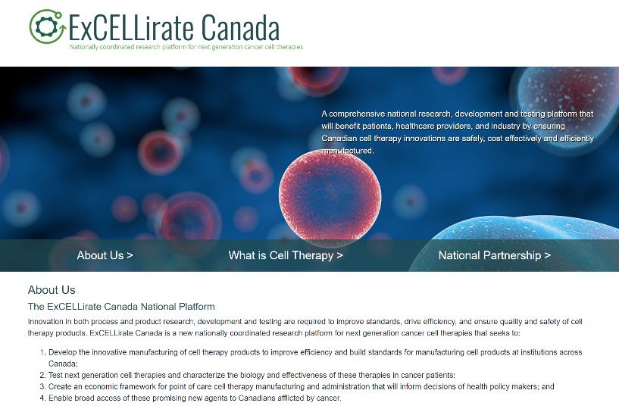
Assisting in Successful Funding
What Benefits Did Patient Engagement Bring?
Grant Applications / Increasing Funding

Slide 37
CCTG Patient Engagement
CCTG Trial Activity and Accrual – Highest in Over a Decade
Evidence of the Patient Engagement having contributed to this success includes Patient Representatives’ reviews and inputs of 100% of CCTG trials at the key touchpoints identified in the clinical trial lifecycle for inclusion of patient-centred endpoints, potential barriers to accrual and patient safety.
In addition to informing practice, patient-centred endpoints inform
patients by providing outcomes that are important to them and their quality of life,
thereby motivating enrollment and retention.
Advocacy
Through use of the collective patient voice, the CCTG Patient Representative Committee has successfully influenced Pharma drug supply decision, additional Cancer Centres opening trials, government funding, etc.
50% Increase in Research Funding in the Past Four Years
  Evidence of (meaningful) patient engagement is a criteria for many granting organizations. CCTG grant applications clearly articulate all CCTG patient representative touchpoints and engagement including specific activities throughout the lifecycle of the specific project and the trial team.

Slide 38
Tips
for engaging
Patient Representatives
38

Slide 39
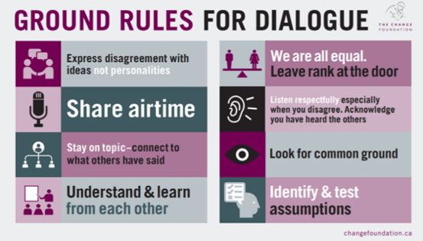
Tips for Engagement
Know what your Patient Representatives in CCTG are trained to do and where to engage them.
Ask, listen, acknowledge.
Expect a different perspective. Patient Reps augment the scientific expertise that is already at the table by
bringing their lived patient experience. Expect your representatives to provide comments on the effects or
results of the science or trial design on the patient or
patient population versus on the science itself.
Be aware of power dynamics within the committee.
Remember that patients are people too, and may
bring an additional professional or cultural perspective.
Be culturally humble and sensitive.
Tap into the patient experience with respect to accrual
planning.
39

Slide 40
Thank you
For more detail:
Needham, J.; Taylor, J.; Nomikos, D. Integrating Patient-Centred Research
in the Canadian Cancer Trials Group. Curr. Oncol. 2021, 28, 630-639.
https://doi.org/10.3390/curroncol28010062
40

